Slide 1
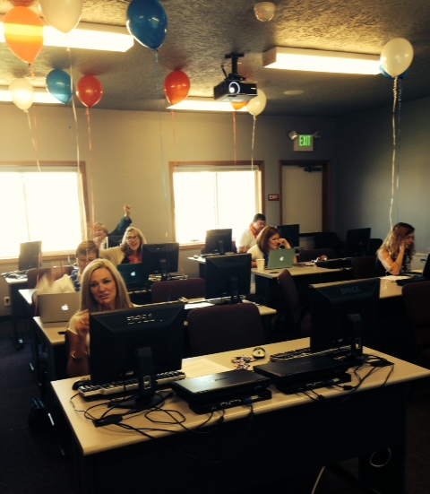
Phone-a-Friend – Phone Bank Wizard
What to prepare:
Create event.
Create phone bank webform for specific phone bank, link event, update engagement levels. *
Refine target list and upload.
Upload volunteer list (.csv file with names and NRDS numbers for each volunteer).
Draft 3 auto-generated emails. These emails will be sent during the phone bank by your volunteers.
Draft phone bank call script.
* State associations update webforms. Each state has a phone bank webform template that can be copied and updated for each phone bank.

Slide 2
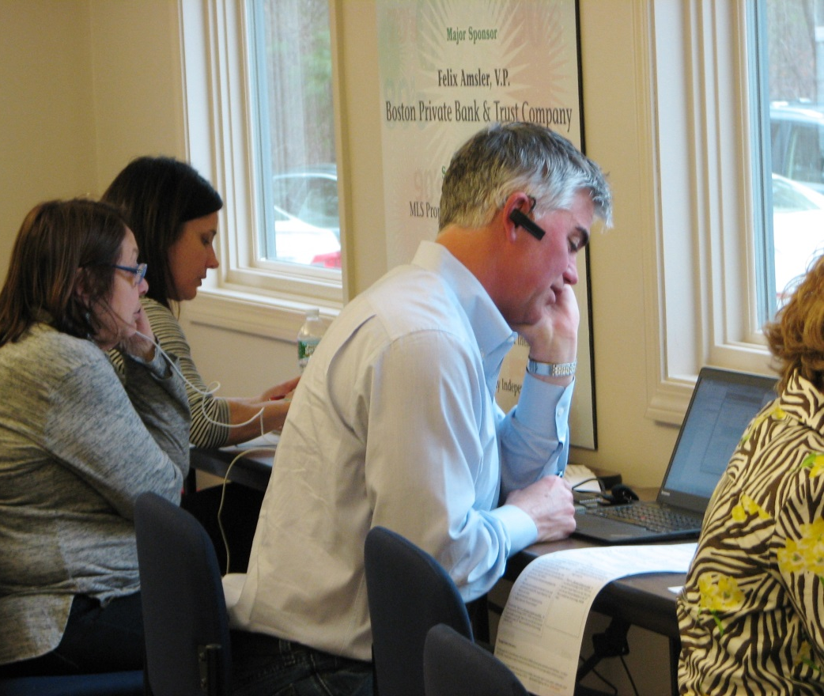
5 Steps of the Phone Bank Wizard
Welcome
Administration
Name your phone bank
Select federated access
Select phone bank webform
List Handling
Upload targets and volunteers
Prioritize call list
Call Script
Paste in call script
Automated Email
Paste in copy for 3 emails that will be generated during the phone bank
Send Email (with investment link)
Thank You Non-Investor
Thank You Investor

Slide 3
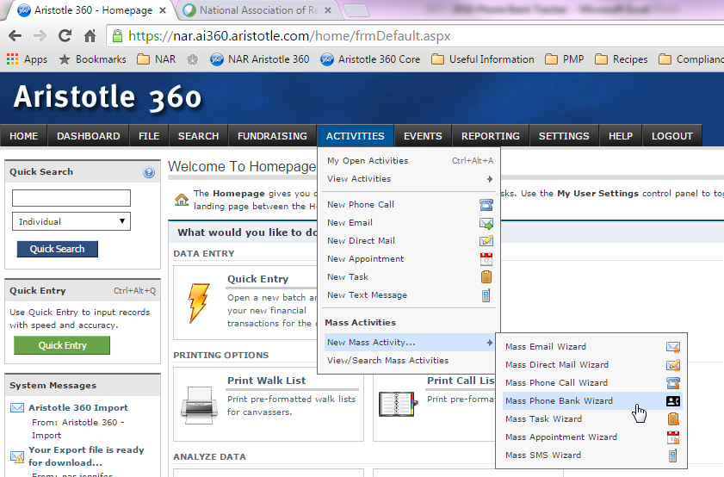
Phone-a-Friend – Phone Bank Wizard Tutorial
To launch the wizard, go to Activities>New Mass Activity>Mass Phone Bank Wizard

Slide 4
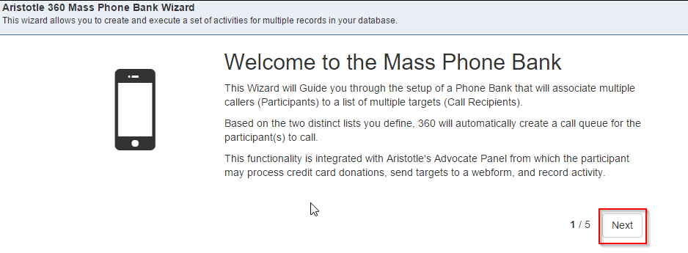
Phone-a-Friend – Phone Bank Wizard Tutorial
There are 5 steps to the phone bank wizard. Step 1 is the “Welcome” screen.
Click “Next.”

Slide 5
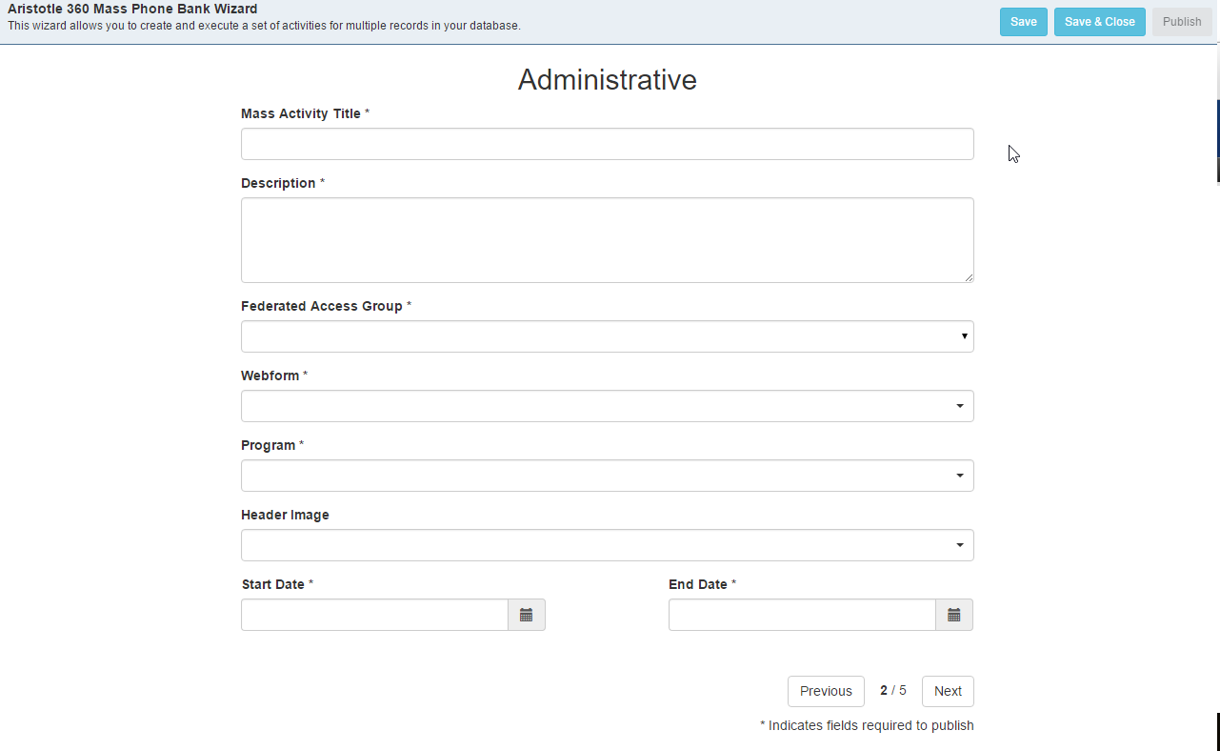
Phone-a-Friend – Phone Bank Wizard Tutorial
Step 2 is the “Administrative” screen. This is where you will start setting up your phone bank.

Slide 6
Phone-a-Friend – Phone Bank Wizard Tutorial
MT-Helena AOR Phone Bank
Enter your phone bank’s name in the Mass Activity Title. Please use the naming convention State Abbreviation-Local Association so it is clearly identifiable.

Slide 7
Phone-a-Friend – Phone Bank Wizard Tutorial
MT-Helena AOR Phone Bank
Calling all members who have never invested or have not invested in 2 or more years
MT-5430
Local Associations only have access to their own federated group. State Associations have access to all the Local Associations in the state.
Add a brief description of your phone bank in the Description field.
Select your Federated Access Group. (This is your state abbreviation and 4-digit Local Board ID)

Slide 8
Phone-a-Friend – Phone Bank Wizard Tutorial
MT-Helena AOR Phone Bank
Calling all members who have never invested or have not invested in 2 or more years
MT-5430
2016 MT Helena Phone Bank
2016 MT Phone Banks
Enter/select the webform name the state association has created for this phone bank in the Webform field
Enter/select the state association’s phone bank program name in the Program field. E.g. 2016 MT Phone Banks

Slide 9
Phone-a-Friend – Phone Bank Wizard Tutorial
MT-Helena AOR Phone Bank
Calling all members who have never invested or have not invested in 2 or more years
MT-5430
2016 MT Helena Phone Bank
2016 MT Phone Banks
Phone Bank Grey
03/03/2016
Enter “Phone Bank Grey” in the Header Image field. Select the image in your federated group
Enter the date of your phone bank into the Start Date field. This is the date queuing of targets will begin. Volunteers will NOT be able to see targets before this date.

Slide 10
Phone-a-Friend – Phone Bank Wizard Tutorial
MT-Helena AOR Phone Bank
Calling all members who have never invested or have not invested in 2 or more years
MT-5430
2016 MT Helena Phone Bank
2016 MT Phone Banks
Phone Bank Logo
03/03/2016
03/04/2016
Enter the last day you want your volunteers to have access to their call queue in the End Date field. This must be at least 1 day after the Start Date.
Click “Save.” This allows you to save your work. Do this often.
Click “Next.”

Slide 11
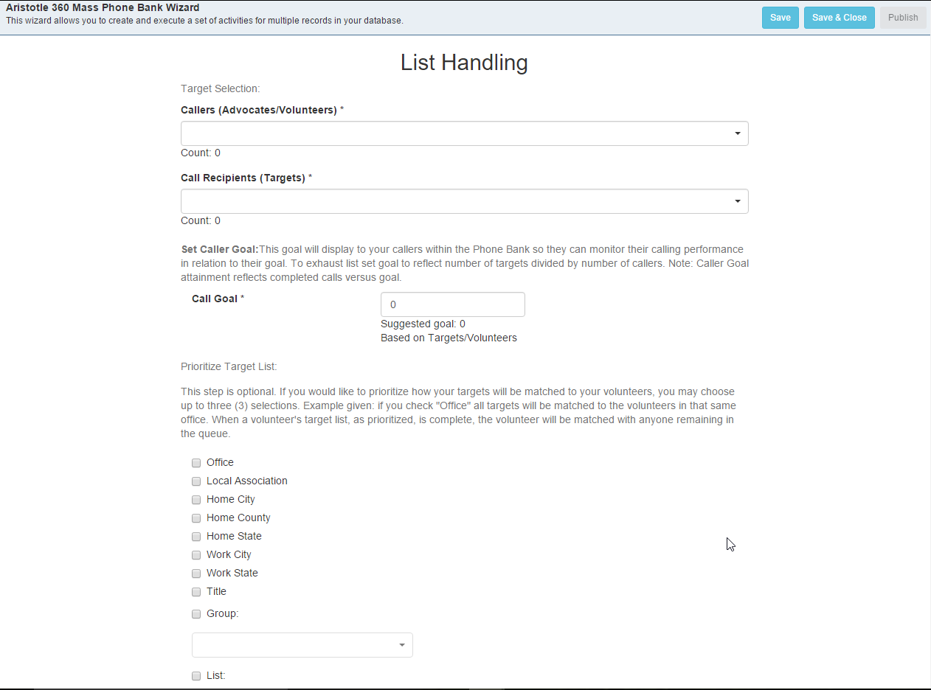
Phone-a-Friend – Phone Bank Wizard Tutorial
Step 3 in the wizard is “List Handling.” This is where you will select your volunteers and targets and build any desired matching between them.

Slide 12
Phone-a-Friend – Phone Bank Wizard Tutorial
Helena Phone Bank Volunteers
Helena Phone Bank Targets
Enter/select the list of volunteers you recently uploaded in the Callers (Advocates/Volunteers) field.
Enter/select the list of targets you recently uploaded or created in the Call Recipients (Targets) field.

Slide 13
Phone-a-Friend – Phone Bank Wizard Tutorial
Helena Phone Bank Volunteers
Helena Phone Bank Targets
40
A call goal will be suggested for you based on the number of targets divided by the number of volunteers. However, you can change that number.
Set your call goal.

Slide 14
Phone-a-Friend – Phone Bank Wizard Tutorial
Helena Phone Bank Volunteers
Helena Phone Bank Targets
40
Prioritize Target List is optional. This is where you can match targets to volunteers. You may choose up to three (3) matching priorities. E.g. if you check “Office” all targets will be matched to the volunteers in that same office. Click “Next.” Don’t forget to save!

Slide 15
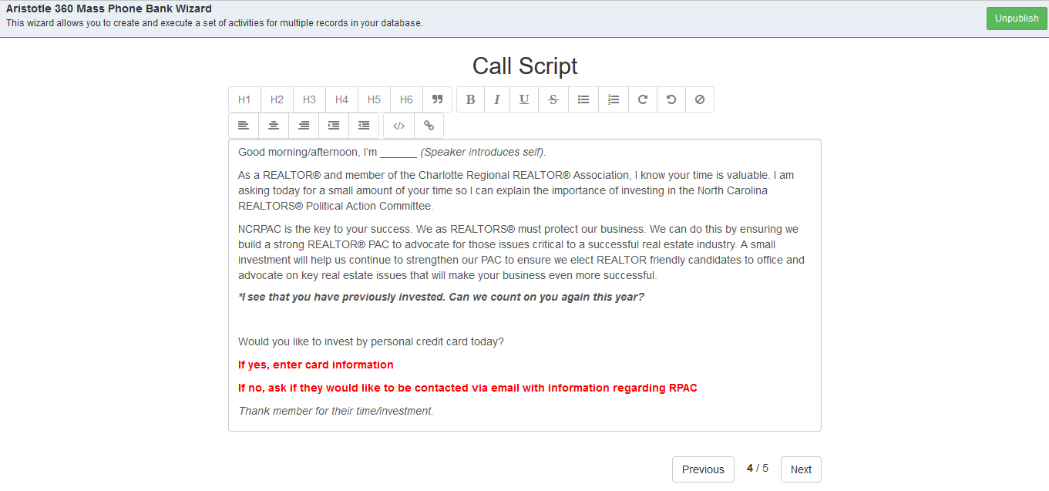
Phone-a-Friend – Phone Bank Wizard Tutorial
Step 4 is where you will load your call script.
Paste your phone bank call script into the Call Script field. Format as you wish.
Click “Next”

Slide 16
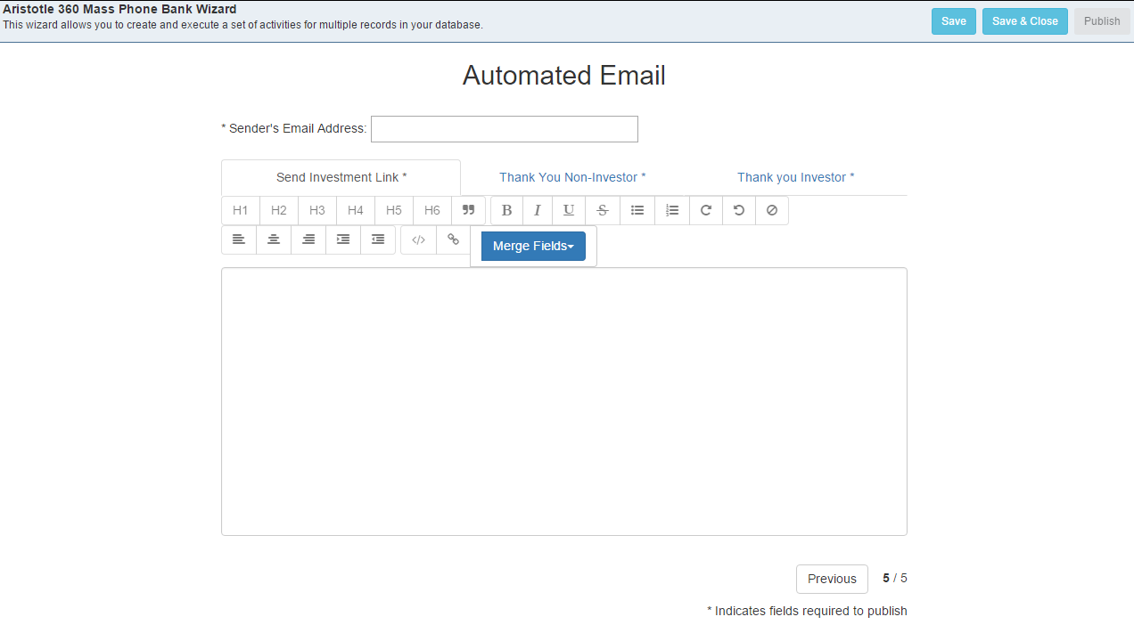
Phone-a-Friend – Phone Bank Wizard Tutorial
Step 5 is where you will load copy for 3-automated emails that will be generated from the Advocate Panel.
The first email “Send Investment Link” is what your volunteers will send to targets who wish to invest, but can’t or won’t do over the phone.

Slide 17
Phone-a-Friend – Phone Bank Wizard Tutorial
info@montanarealtors.org
Dear ,
Thank you so much for your time today. To make an investment, please click the link below! We appreciate your commitment.
Add the “Sender’s Email Address” in the top line. It would be best if this is an address from the Association.
Paste in your message.

Slide 18
Phone-a-Friend – Phone Bank Wizard Tutorial
info@montanarealtors.org
Dear ,
Thank you so much for your time today. To make an investment, please click the link below! We appreciate your commitment.
To personalize your message, add merge fields.

Slide 19
Phone-a-Friend – Phone Bank Wizard Tutorial
info@montanarealtors.org
Dear [First Name],
Thank you so much for your time today. To make an investment, please click the link below! We appreciate your commitment.
Repeat numbers 24 and 25 for the “Thank You Non-Investor” and “Thank You Investor” tabs.
Click Save.

Slide 20
Phone-a-Friend – Phone Bank Wizard Tutorial
Publish
info@montanarealtors.org
Dear [First Name],
Thank you so much for your time today. To make an investment, please click the link below! We appreciate your commitment.
When you have finished everything, click the green Publish button, and your phone bank is available to publish for volunteers to see.

Slide 21
When you have finished the wizard, follow the instructions for Enabling Advocates and Emailing Advocates
Run Phone Bank Wizard
Enable Advocates
Email Advocates

