Slide 2
Eviction Moratorium NAR Advocacy Team September 9, 2020 Dial In: 1-855-797-9485 Access code: 145 741 0086

Slide 3
Background & The Ask
The Politics
State of Play
The Ask

Slide 4
CDC Order
September 4 – December 31
All rental units
Except those more protective
Not American Samoa
Virtually ALL RENTERS
Must sign self-certification

Slide 5
Resident Declaration
Under penalty of perjury, that you:
Make less than $99k/$198k
Used best efforts to obtain rental assistance or housing assistance
Unable to pay due to loss of income, wages, or medical bills
DOES NOT HAVE TO BE COVID-related
If evicted, would more into a homeless shelter or crowded housing

Slide 6
Landlord may:
Evict for non-payment of rent;
Charge late fees, penalties, and interest; per the terms of the lease

Slide 7
Why do REALTORS Care?
25% of REALTORS own/manage rental properties
46% of all rental units are owned by “mom and pops” and another 37% are owned by LLCs – NOT Big corporations
Impact on the housing market – imagine the eviction crisis that will hit in January 2021

Slide 8
What the Solution?
RENTAL ASSISTANCE
HEROES Act (passed by the House) provide $100 billion to those making less than 80% of AMI – far fewer than CDC order

Slide 9
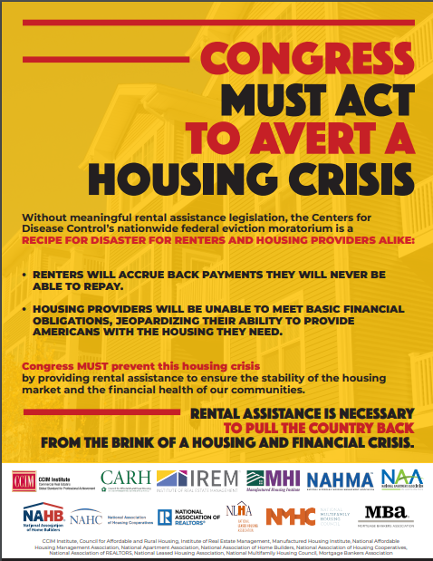
What Else?
Work with our coalition partners
Legal Action?

Slide 10
What & How should I Report?
FILE A FIELD REPORT
OR
Contact Your Political Representative
Be Timely (within 24 hours of your contact)

Slide 11
NATIONAL ASSOCIATION OF REALTORS®
State Assignments for Political Representatives
AK
WA
VT
ME
MT
ND
April Gavin
OR
MN
NH
ID
SD
WI
NY
MA
Drew Myers
WY
MI
RI
IA
PA
CT
Zack Rubin-McCarry
NV
NE
NJ
UT
IL
IN
OH
DE
CO
MD
Kristian Hoysradt
CA
KS
MO
WV
VA
KY
DC
NC
Patrick Wohl
Hawaii
AZ
OK
TN
NM
AR
SC
Jack Greacen
MS
AL
GA
Guam
LA
TX
United States
Virgin Islands
American Samoa
FL
Puerto Rico

